Slide 1
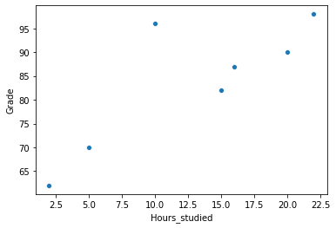
Data Science Workflow
A Simple Example
“If I study more, will I get a high grade?”
1. Start with a Question
Student | Hours Studied | Grade
Hemanth | 20 | 90
Vivek | 5 | 70
Adarsh | 10 | 96
Avinash | 15 | 82
Shruthi |  | 62
Priyanka | 16 | 87
Prasanna | 22
2. Get & Clean the Data
Modeling , evaluating
and Share Results
3. Perform EDA
Finding#1: The more you study, the higher grade you will get
4. Modeling and Evaluating
two
2
5. Share Results
Finding#2: Also, Adarsh is a smarty pants.
98
998

Slide 2
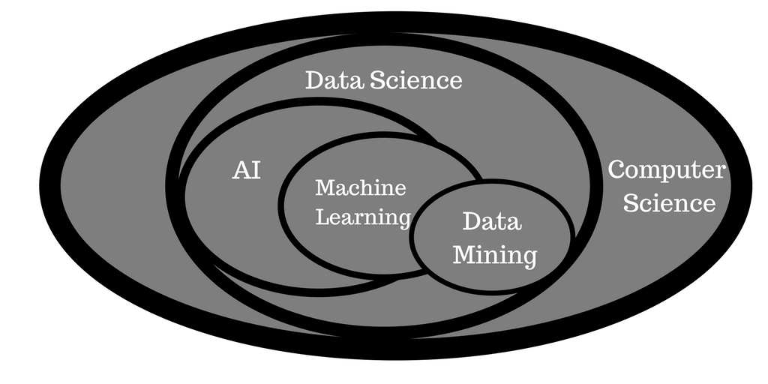
Machine Learning
Machine learning (ML) is the study of computer algorithms that improve automatically through experience. It is seen as a subset of artificial intelligence.

Slide 3
Machine Learning Types
Machine Learning Types
Supervised ML( Predictive Task)
Unsupervised ML(Descriptive Task)
Continuous Target Data
Categorical Target Data
Target Variable not Available
Regression
Classification
Clustering
Association
Grade Prediction
House Price Prediction
Sales Prediction
Medical Imaging
Customer will buy or will not buy
Customer Segmentation
Document Clustering
Market Basket
Analysis
Algorithms Ex:
Linear Regression
Neural Networks etc.
Algorithms Ex:
Logistic Regression
SVM, Naïve Bayes, DTs.etc
Algorithms Ex:
K-means, DB SCAN etc
Algorithms Ex:
Apriori Eclat , FP growthetc

Slide 4
Machine Learning Process

Slide 5
Acquire Data from Some Source
Data
Acquisition

Slide 6
Clean and Organize the Data
Data
Acquisition
Data
Cleaning

Slide 7
Train Test Split
Test
Data
Acquisition
Data
Cleaning
Train

Slide 8
Train/Fit Model on Training Data
Test
Data
Acquisition
Data
Cleaning
Train
Model
Train

Slide 9
Evaluate Model on Test Data
Test
Data
Acquisition
Data
Cleaning
Train
Model
Evaluate
Model
Train

Slide 10
Adjust Model Parameters
Test
Data
Acquisition
Data
Cleaning
Train
Model
Evaluate
Model
Train
Adjust Model Parameters

Slide 11
Deploy Model on New Incoming Data
Test
Data
Acquisition
Data
Cleaning
Train
Model
Evaluate
Model
Deploy
Model
Train
Adjust Model Parameters

Slide 12
Unsupervised Learning
Data
Acquisition
Data
Cleaning
Train
Model
Evaluate
Model
Deploy
Model
Train
Adjust Model Parameters

Slide 13
Outline
What is a linear model?
For regression: linear regression
For classification: logistic regression
Non linearly separable data
Advantages and Disadvantages

Slide 14
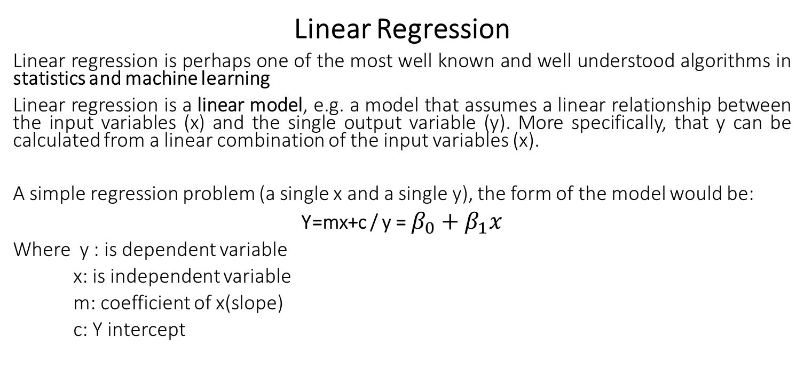
Back to Step 4. of Data Science Workflow - Apply Machine Learning Algorithm
Linear Regression
Linear regression is perhaps one of the most well known and well understood algorithms in statistics and machine learning
Linear regression is a linear model, e.g. a model that assumes a linear relationship between the input variables (x) and the single output variable (y). More specifically, that y can be calculated from a linear combination of the input variables (x).
A simple regression problem (a single x and a single y), the form of the model would be:
Y=mx+c / y = $β_{0}+β_{1}x$
Where y : is dependent variable
x: is independent variable
m: coefficient of x(slope)
c: Y intercept

Slide 15
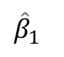
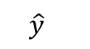
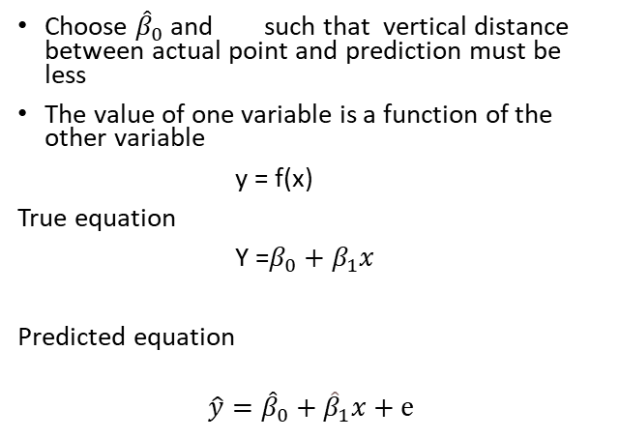
EX: 1. Prediction of Grade(Y) given Hours studied(X) 2. Predicting the house price(Y) given house size(X)
https://setosa.io/ev/ordinary-least-squares-regression/
SHARE INSIGHTS…
“If I study more, will I get a higher grade?”
Yes, there is a positive correlation between the number of hours you study and the grade you will get
Specifically, the relationship is Grade= 65+1.5 * hours
So, if you study 10 hours, you can expect to get an 76
However, Adarsh is a smarty pants and is inflating the grade estimate.
You will probably get slightly less than 80
(62-65)^2+(69-70)^2+(75-96)^2+(81-85)^2+(86-86)^2+(87-89)^2+(97-96)^2 =9+1+441+16+0+4+1=472/7=67
$${\hat{β}}_{1}$$
Choose ${\hat{β}}_{0}$and such that vertical distance between actual point and prediction must be less
The value of one variable is a function of the other variable
y = f(x)
True equation
Y =$β_{0}+β_{1}x$
Predicted equation
$$\hat{y}={\hat{β}}_{0}+{\hat{β}}_{1}x+ⅇ$$
$$\hat{y}$$

Slide 16
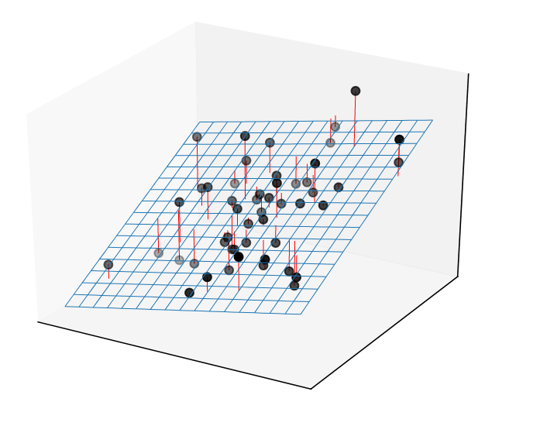
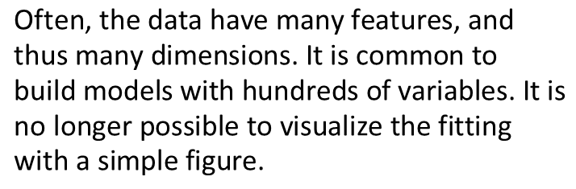
Linear regression with several variables
The mental picture needs to be extended to several dimensions.
$$\text{Often}\text{, }\text{the} \text{data} \text{have} \text{many} \text{features}\text{, }\text{and} \text{thus} \text{many} \text{dimensions}\text{. }\text{It} \text{is} \text{common} \text{to} \text{build} \text{models} \text{with} \text{hundreds} \text{of} \text{variables}\text{. }\text{It} \text{is} \text{no} \text{longer} \text{possible} \text{to} \text{visualize} \text{the} \text{fitting} \text{with} \text{a} \text{simple} \text{figure}\text{.}$$

Slide 17
Assumptions of Linear Models
Linear Relationship between predictors and response variable
Errors are normally distributed
No Multicollinearity between predictor variables
Homoskedasticity – same variability around the regression line

Slide 18
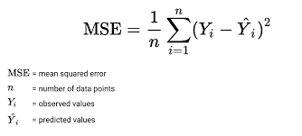
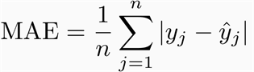
Metrics for Linear Regression
MSE (mean squared error) is a loss metrics(functions). They are used to evaluate a regression model. The lesser the MSE the better the model.
MAE( mean absolute error) is a loss metrics. The lesser the MBE the better the model

Slide 19
Evaluating Model
The raw MSE can be difficult to interpret. One way is to rescale the MSE by the variance of the target. This score is known as the 𝑅2 also called the coefficient of determination
R2 Squared measures of how well a regression model(best fit line) predicts the targets. The higher the R2, the better the model. The best score is 1 and sometimes it is also negative

Slide 20
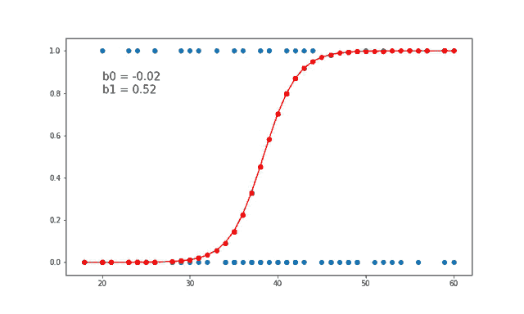
Classification (Supervised Learning)
Logistic Regression
Based on linear Regression
Probability Problem
Classify either true or false, spam or ham, buy or not buy etc
Ex: Probability of getting infected given age

Slide 21
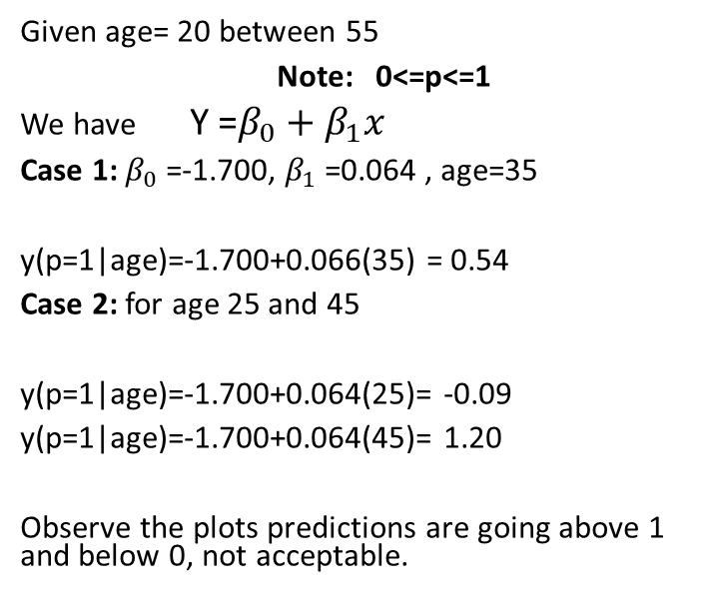
Let’s try to solve this using Linear Regression
Given age= 20 between 55
Note: 0<=p<=1
We have Y =$β_{0}+β_{1}x$
Case 1: $β_{0}$=-1.700, $β_{1}$=0.064 , age=35
y(p=1|age)=-1.700+0.066(35) = 0.54
Case 2: for age 25 and 45
y(p=1|age)=-1.700+0.064(25)= -0.09
y(p=1|age)=-1.700+0.064(45)= 1.20
Observe the plots predictions are going above 1 and below 0, not acceptable.
2.5
2
1.5
Infection(y)
1
0.5
0
20
25
30
35
40
45
50
55
-1
Age(x)

Slide 22
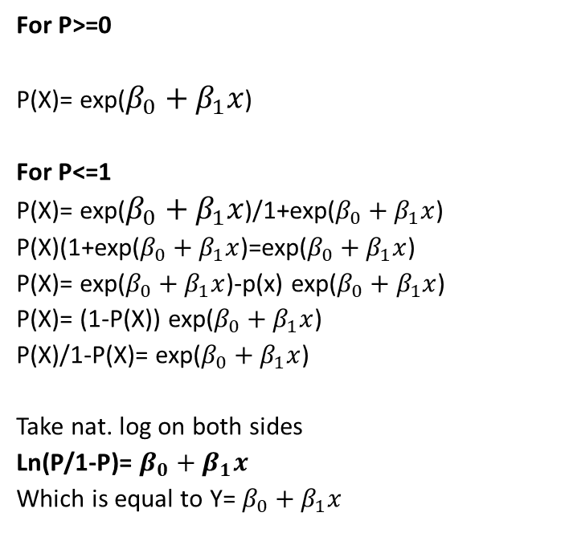
Let’s try do some Engineering to this
For P>=0
P(X)= exp($β_{0}+β_{1}x$)
For P<=1
P(X)= exp($β_{0}+β_{1}x$)/1+exp($β_{0}+β_{1}x$)
P(X)(1+exp($β_{0}+β_{1}x$)=exp($β_{0}+β_{1}x$)
P(X)= exp($β_{0}+β_{1}x$)-p(x) exp($β_{0}+β_{1}x$)
P(X)= (1-P(X)) exp($β_{0}+β_{1}x$)
P(X)/1-P(X)= exp($β_{0}+β_{1}x$)
Take nat. log on both sides
Ln(P/1-P)= $β_{0}+β_{1}x$
Which is equal to Y= $β_{0}+β_{1}x$
2.5
2
1.5
Infection(y)
1
0.5
0
20
25
30
35
40
45
50
55
-1
Age(x)

Slide 23
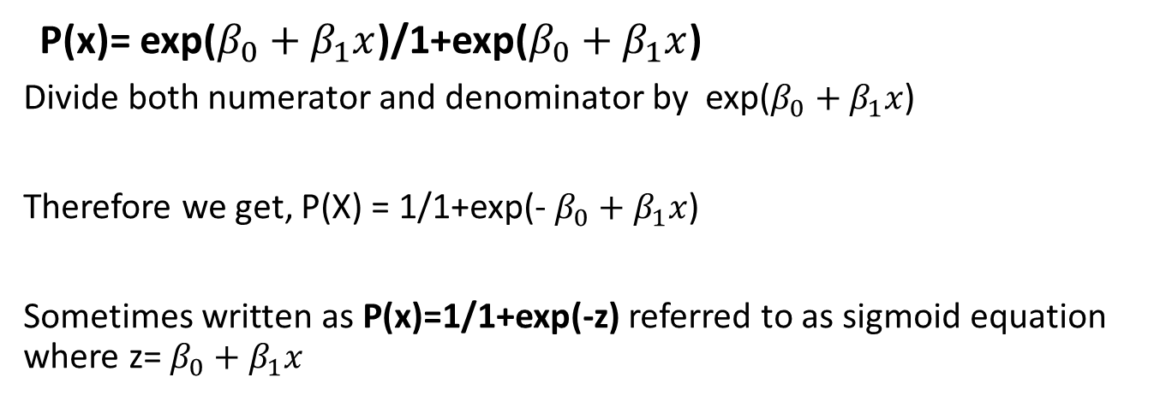
P(x)= exp($β_{0}+β_{1}x$)/1+exp($β_{0}+β_{1}x$)
Divide both numerator and denominator by exp($β_{0}+β_{1}x$)
Therefore we get, P(X) = 1/1+exp(- $β_{0}+β_{1}x$)
Sometimes written as P(x)=1/1+exp(-z) referred to as sigmoid equation where z= $β_{0}+β_{1}x$

Slide 24
Evaluating Classification Model
The key classification metrics we need to understand are:
Accuracy
Recall
Precision
F1-Score
Let’s understand
Typically in any classification task your model can only achieve two results:
Either your model was correct in its prediction.
Or your model was incorrect in its prediction.

Slide 25

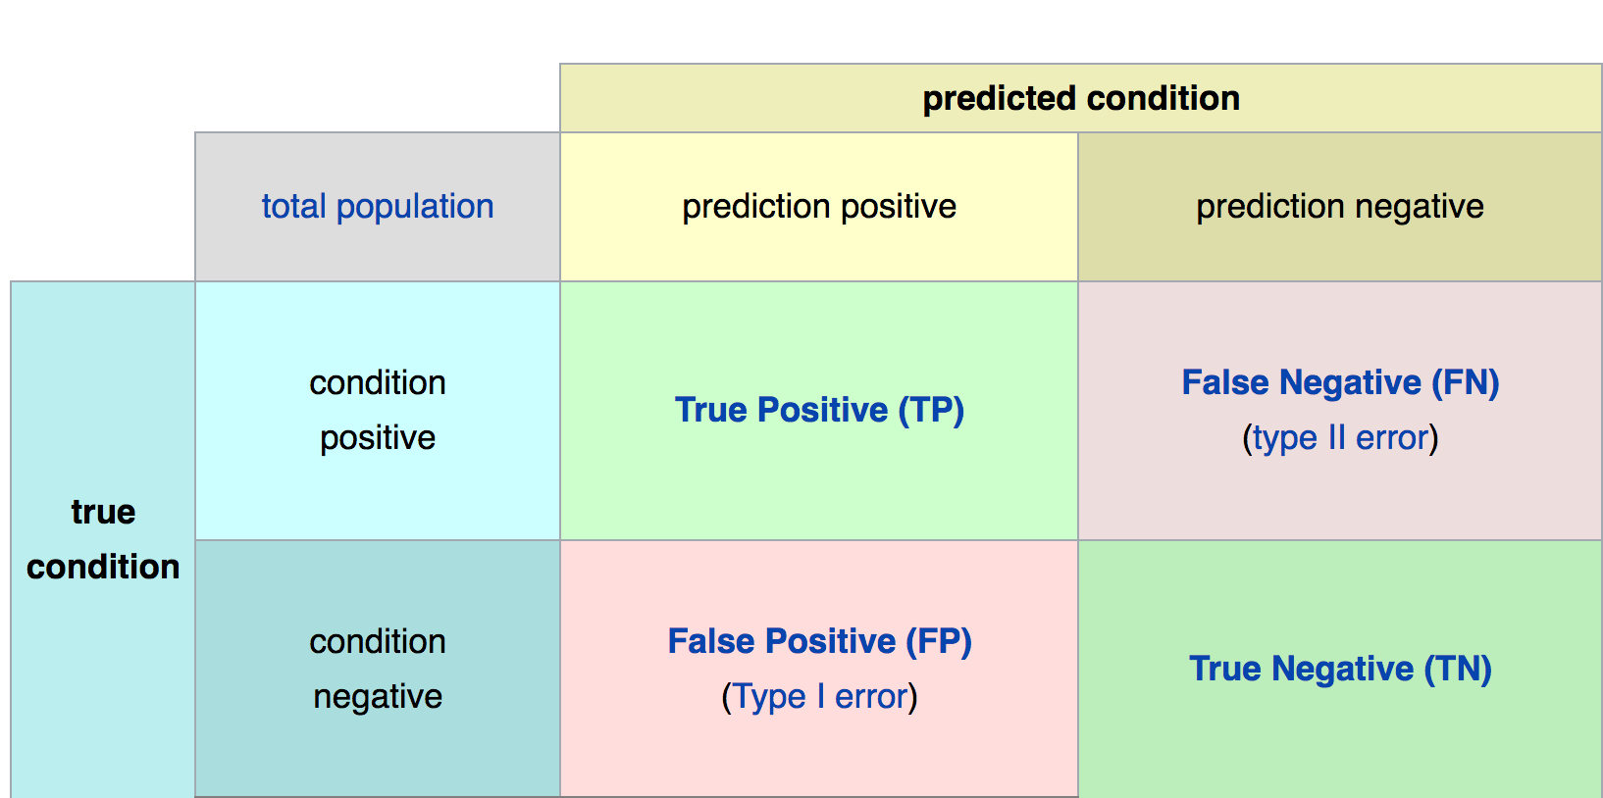
Confusion matrix
=
=
=
=
=

Slide 26
Accuracy
Accuracy in classification problems is the number of correct predictions made by the model divided by the total number of predictions.
Accuracy =Number of correct predictions/ total number of predictions.
Accuracy = TP+TN/TP+TN+FN+FP

Slide 27
In this situation we’ll want to understand precision and recall
Precision is a metric that quantifies the number of correct positive predictions made.
It is calculated as the ratio of correctly predicted positive examples divided by the total number of positive examples that were predicted
Precision = TruePositives / (TruePositives + FalsePositives)
Recall is a metric that quantifies the number of correct positive predictions made out of all positive predictions that could have been made.
Unlike precision that only comments on the correct positive predictions out of all positive predictions, recall provides an indication of missed positive predictions.
Recall = TruePositives / (TruePositives + FalseNegatives)

Slide 28
Precision: Appropriate when minimizing false positives is the focus.
Recall: Appropriate when minimizing false negatives is the focus.
F-Measure provides a way to combine both precision and recall into a single measure that captures both properties.
F-Measure = (2 * Precision * Recall) / (Precision + Recall)

Slide 29
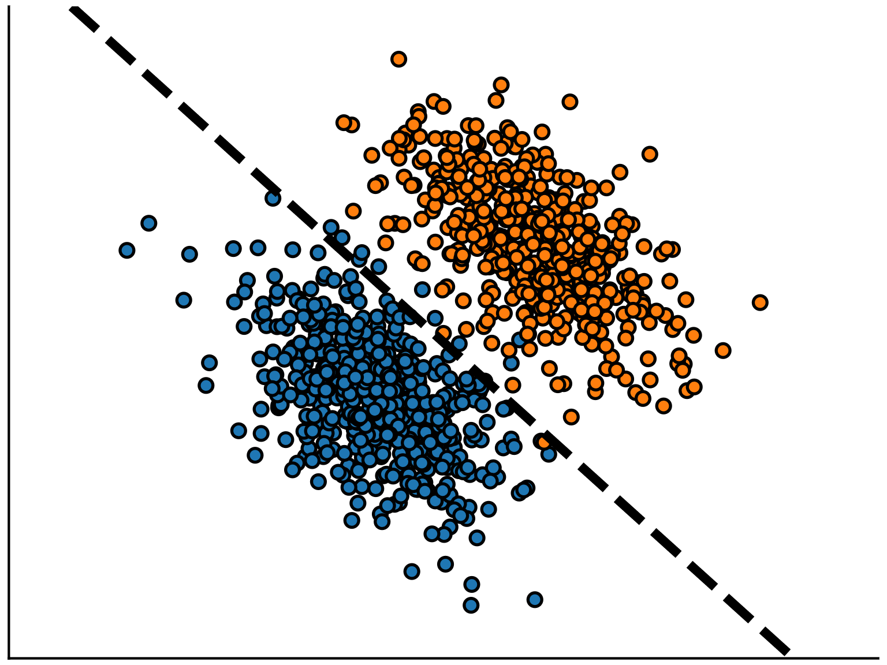
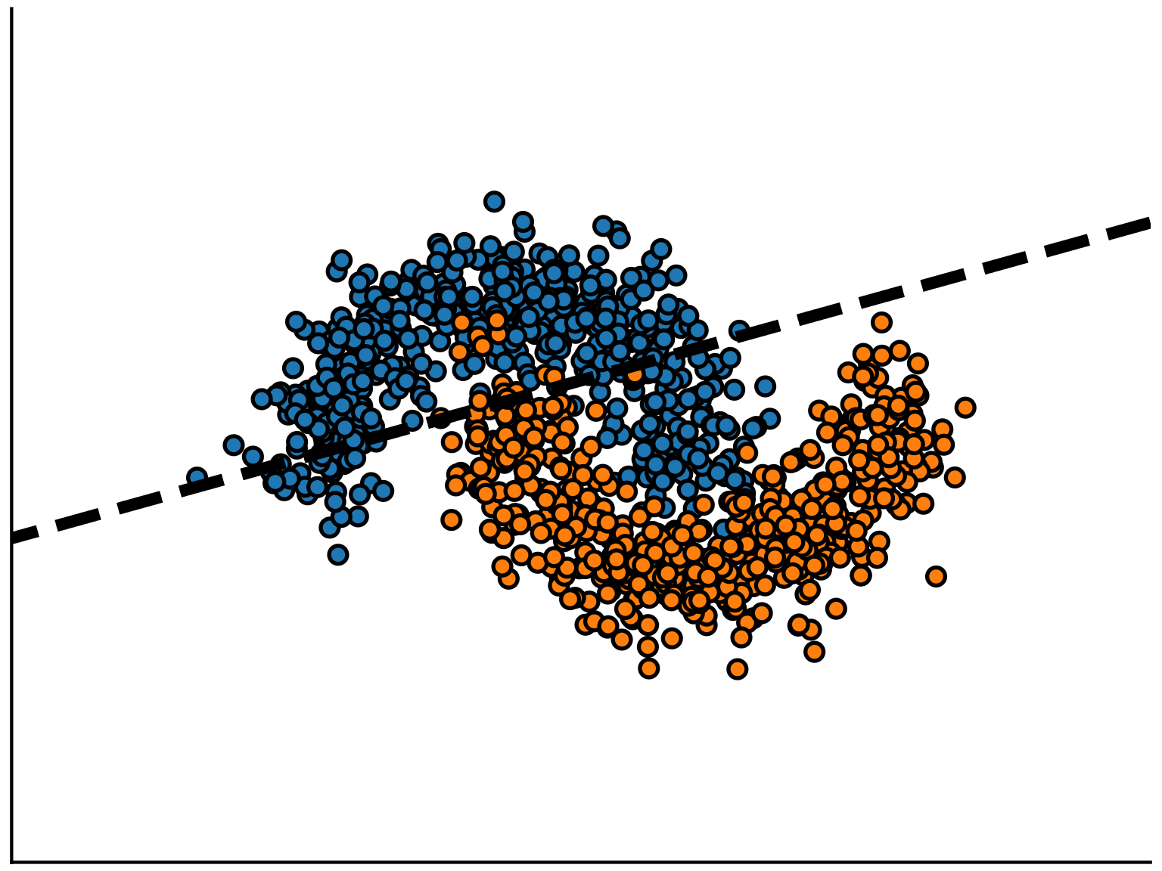
Non Linear Data

Slide 30
Linear models work well if the classes are (almost) linearly separable.
However, sometimes, the best decision boundary to separate classes is not well approximated by a straight line.
In such a situation, we can either use non-linear models.

Slide 31
Advantages and Disadvantages of Linear Regression
1.They are simple and easy to understand
2. Linear models are fast to train and fast to predict, and hence convenient to interactively design predict models but also more efficient to deploy in production at scale and on energy limited hardware (mobile phones).
Disadvantages
1.Asssumes linear Relationships between independent and dependent variables
2. Linear regression is very sensitive to the anomalies in the data.
3.
Can underfit when:
n_features << n_samples → engineering new features can help!

Slide 32
Logistics Regression Advantages and Disadvantages
Advantages:
Logistic Regression is an algorithm that is relatively simple and powerful for deciding between two classes, i.e. binary classifier.
It is more robust: the independent variables don’t have to be normally distributed
It does not assume a linear relationship between the independent and dependent variables
Disadvantages:
Limited Outcome Classification : Can be only used for Binary classification
Models are vulnerable to overconfidence / Overfitting.

Slide 33
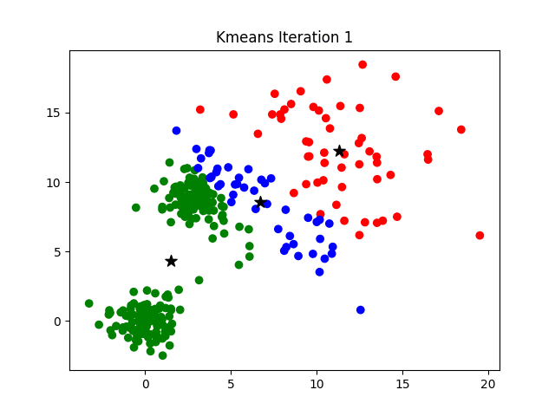
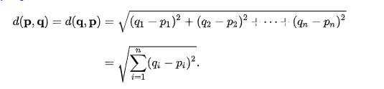
Unsupervised ML K-means Algorithm
Input:
k: the number of clusters,
D: a data set containing n objects.
Output: A set of k clusters.
Method:
(1) arbitrarily choose k objects from D as the initial cluster centers;
(2) repeat
(3) (re)assign each object to the cluster to which the object is the most similar,
based on the mean value of the objects in the cluster;
(4) update the cluster means, that is, calculate the mean value of the objects for
each cluster;
(5) until no change;
https://scikit-learn.org/stable/modules/clustering.html

Slide 34

Decision Tree
Decision Tree is a Supervised Machine Learning algorithm considered to be one of the best and mostly used for classification problems. It can be used both for classification and regression task
Decision Tree Terminologies
Root Node: Root node is from where the decision tree starts. It represents the entire dataset, which further gets divided into two or more homogeneous sets.
Leaf Node: Leaf nodes are the final output node, and the tree cannot be segregated further after getting a leaf node.
Splitting: Splitting is the process of dividing the decision node/root node into sub-nodes according to the given conditions.
Branch/Sub Tree: A tree formed by splitting the tree.
Pruning: Pruning is the process of removing the unwanted branches from the tree.
Parent/Child node: The root node of the tree is called the parent node, and other nodes are called the child nodes.

Slide 35
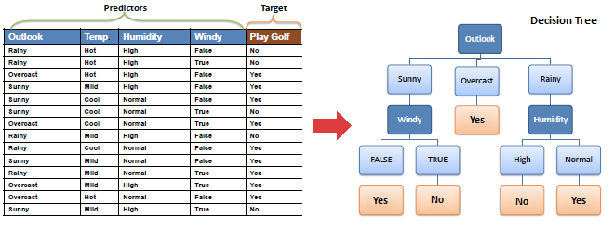
Decision Tree Example
Here are 14 instances of golf playing decisions based on outlook, temperature, humidity and wind factors.

Slide 36
How does the Decision Tree algorithm Work?
Step-1: Begin the tree with the root node, says S, which contains the complete dataset.
Step-2: Find the best attribute in the dataset using Attribute Selection Measure (ASM).
Step-3: Divide the S into subsets that contains possible values for the best attributes.
Step-4: Generate the decision tree node, which contains the best attribute.
Step-5: Recursively make new decision trees using the subsets of the dataset created in step -3. Continue this process until a stage is reached where you cannot further classify the nodes and called the final node as a leaf node.

Slide 37
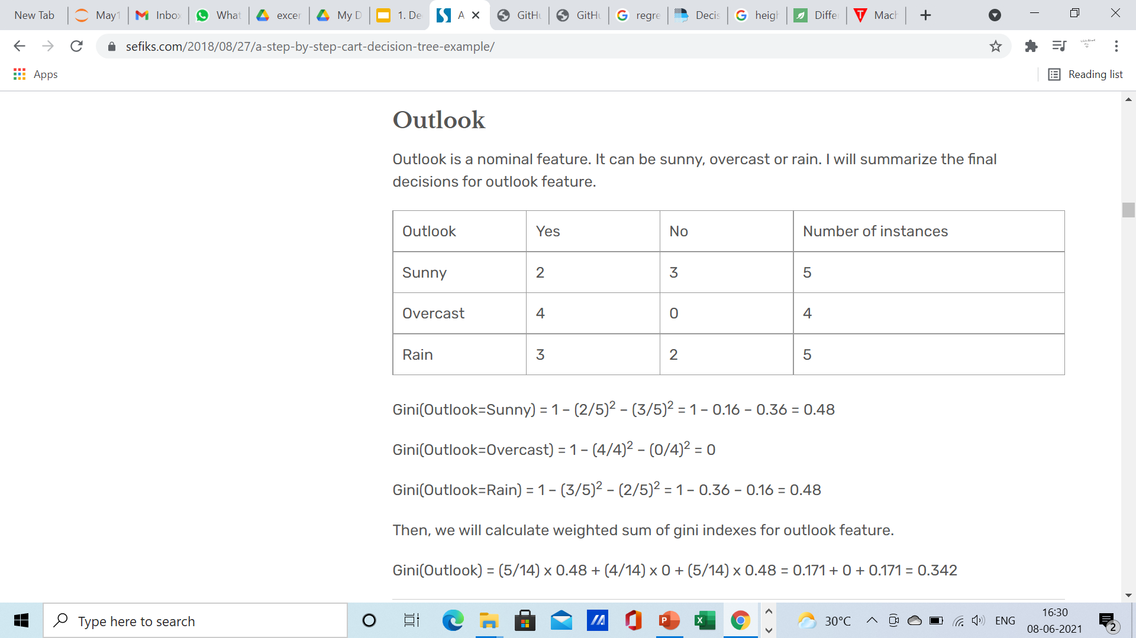
Gini index
Gini index is a attribute selection measure. It stores sum of squared probabilities of each class. We can formulate it as illustrated below.
Gini = 1 – Σ (Pi)² for i=1 to number of classes

Slide 38
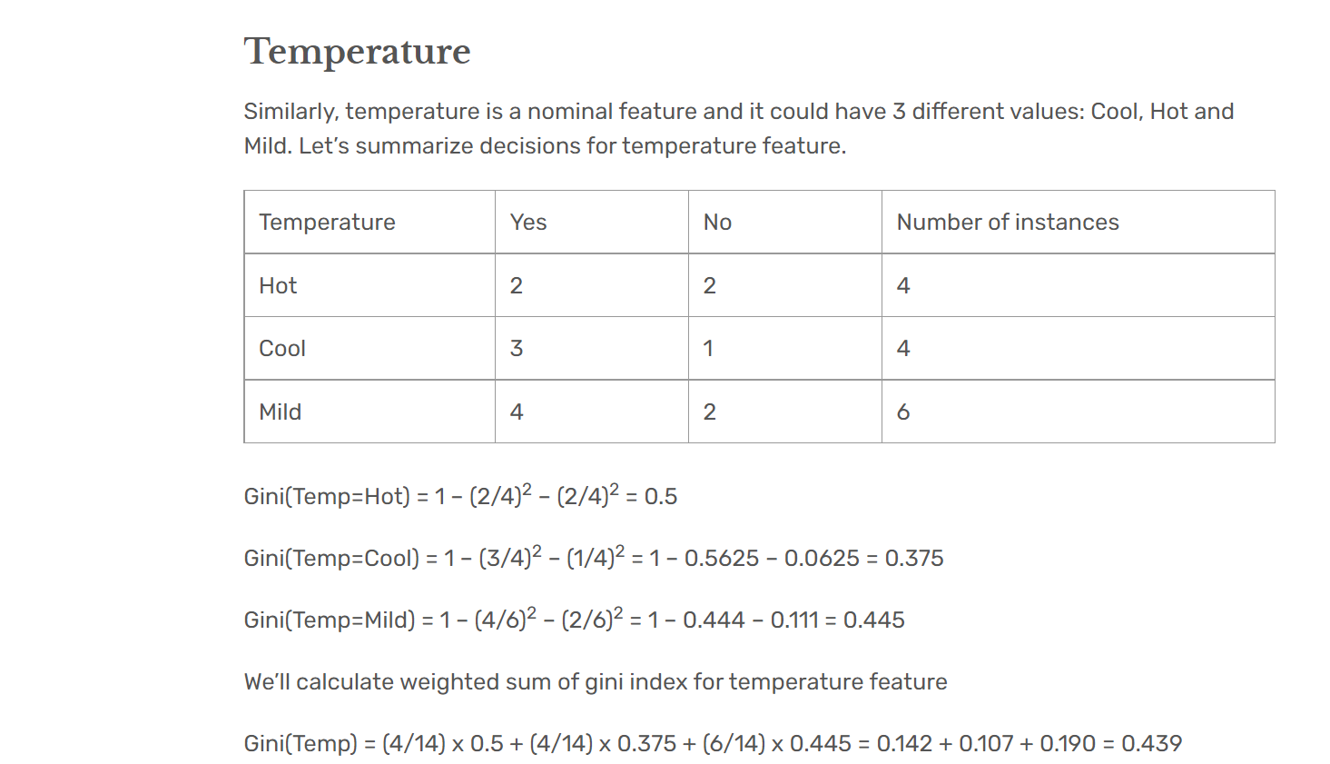

Slide 39
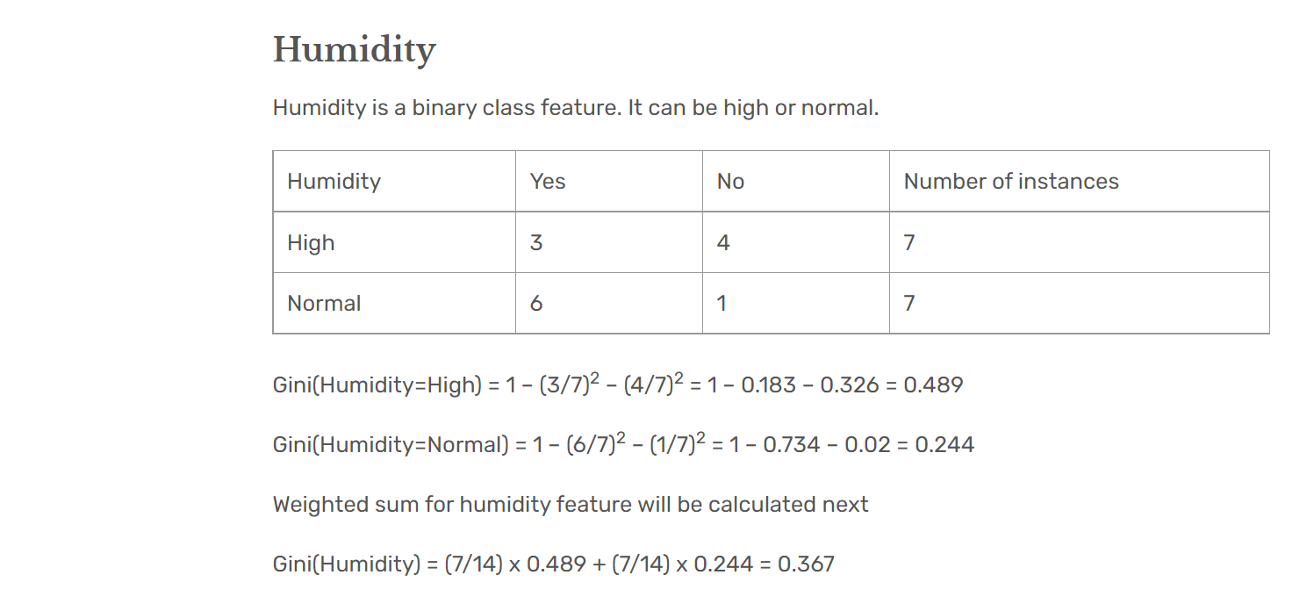

Slide 40
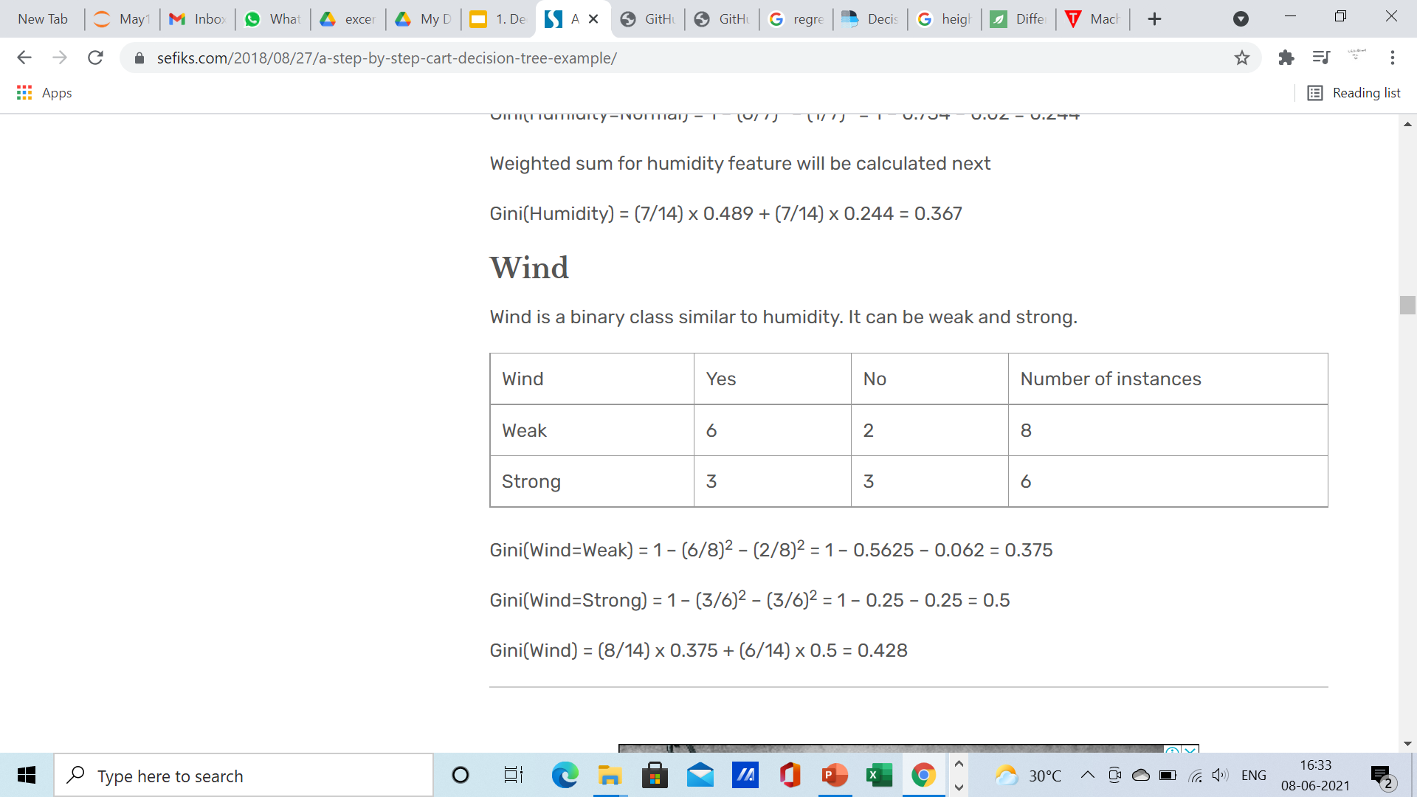
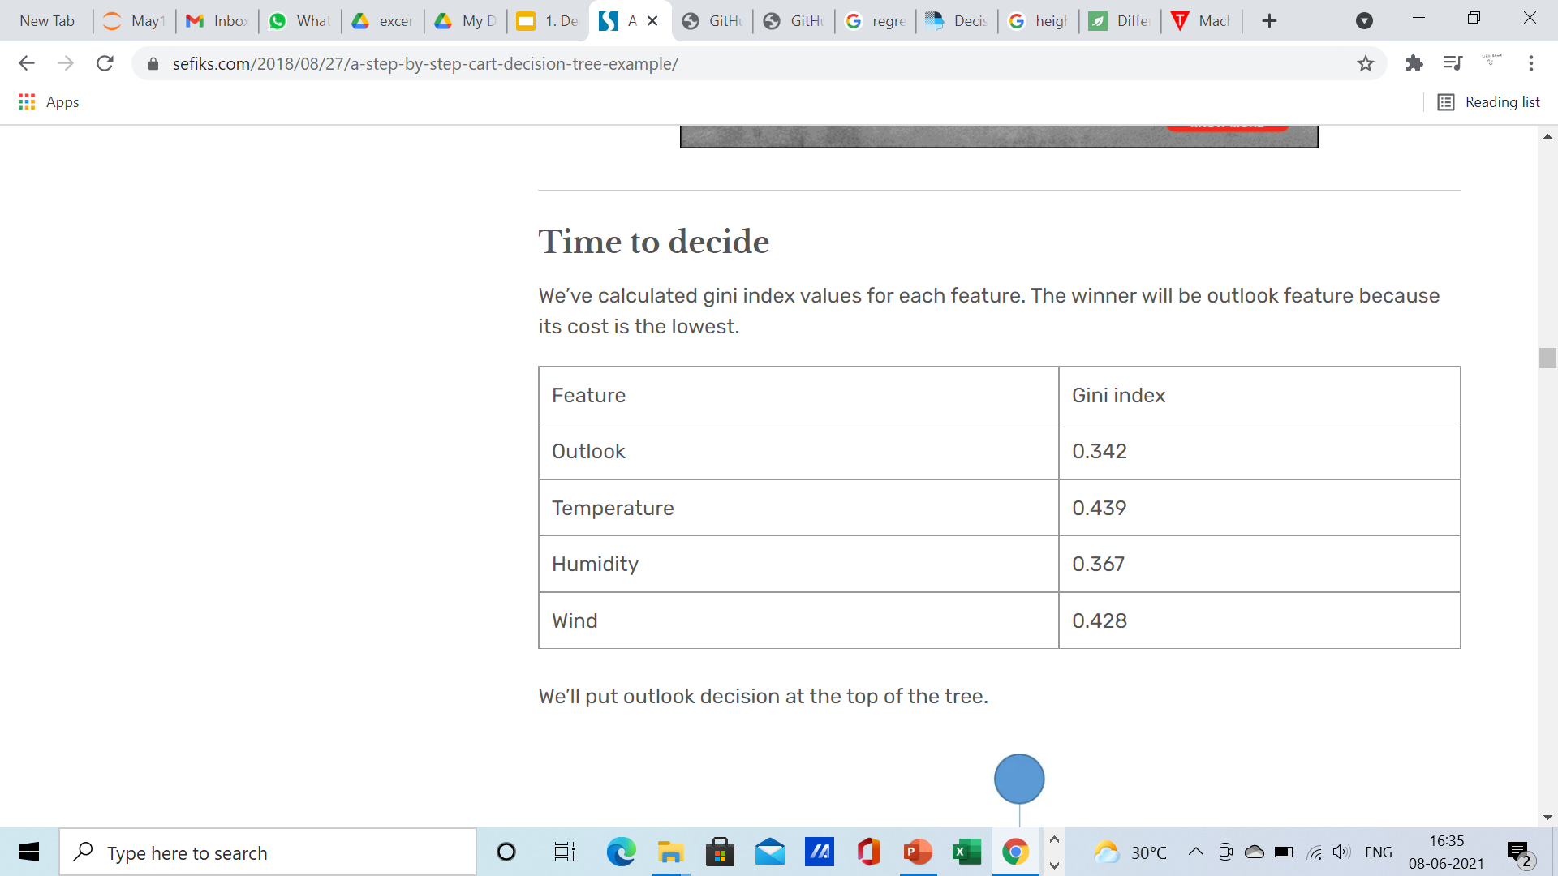

Slide 41
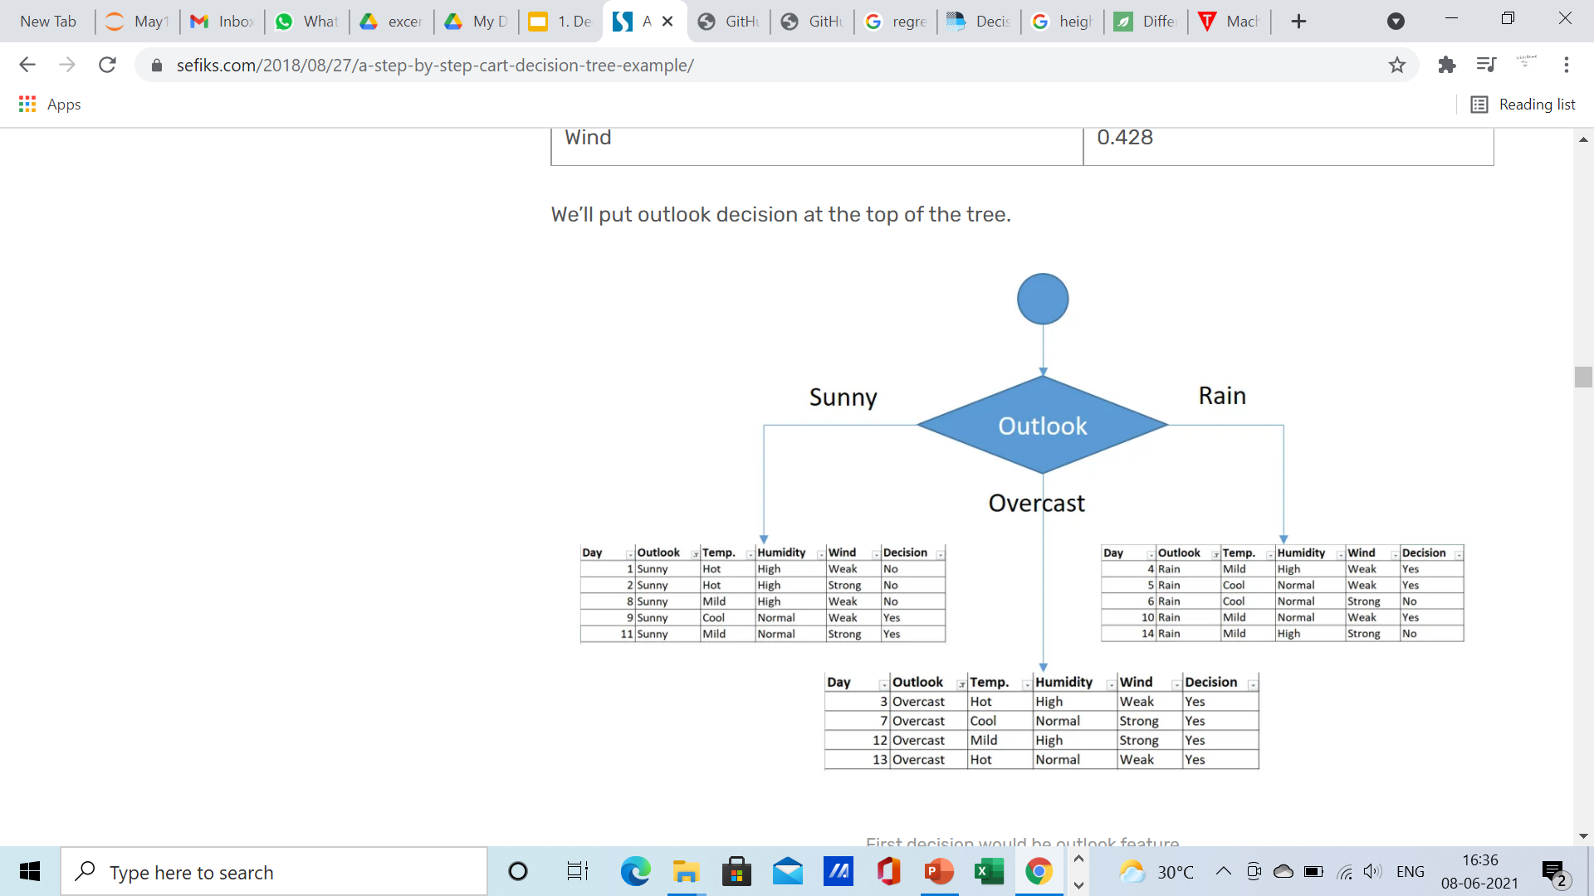
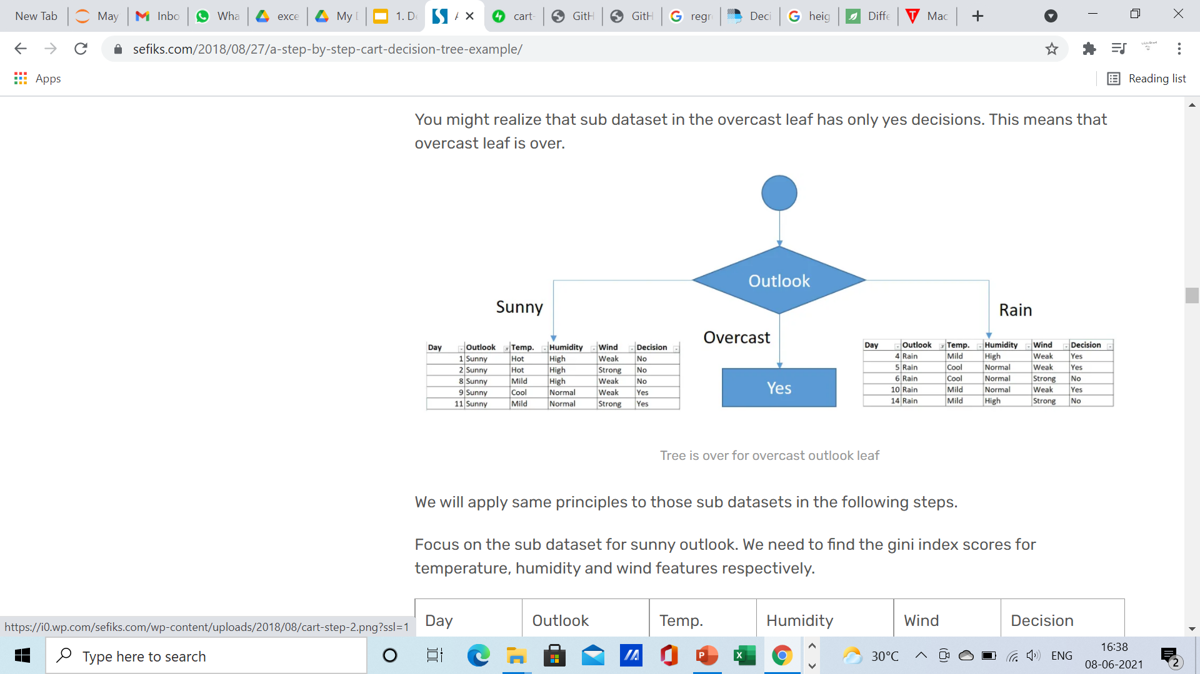

Slide 42
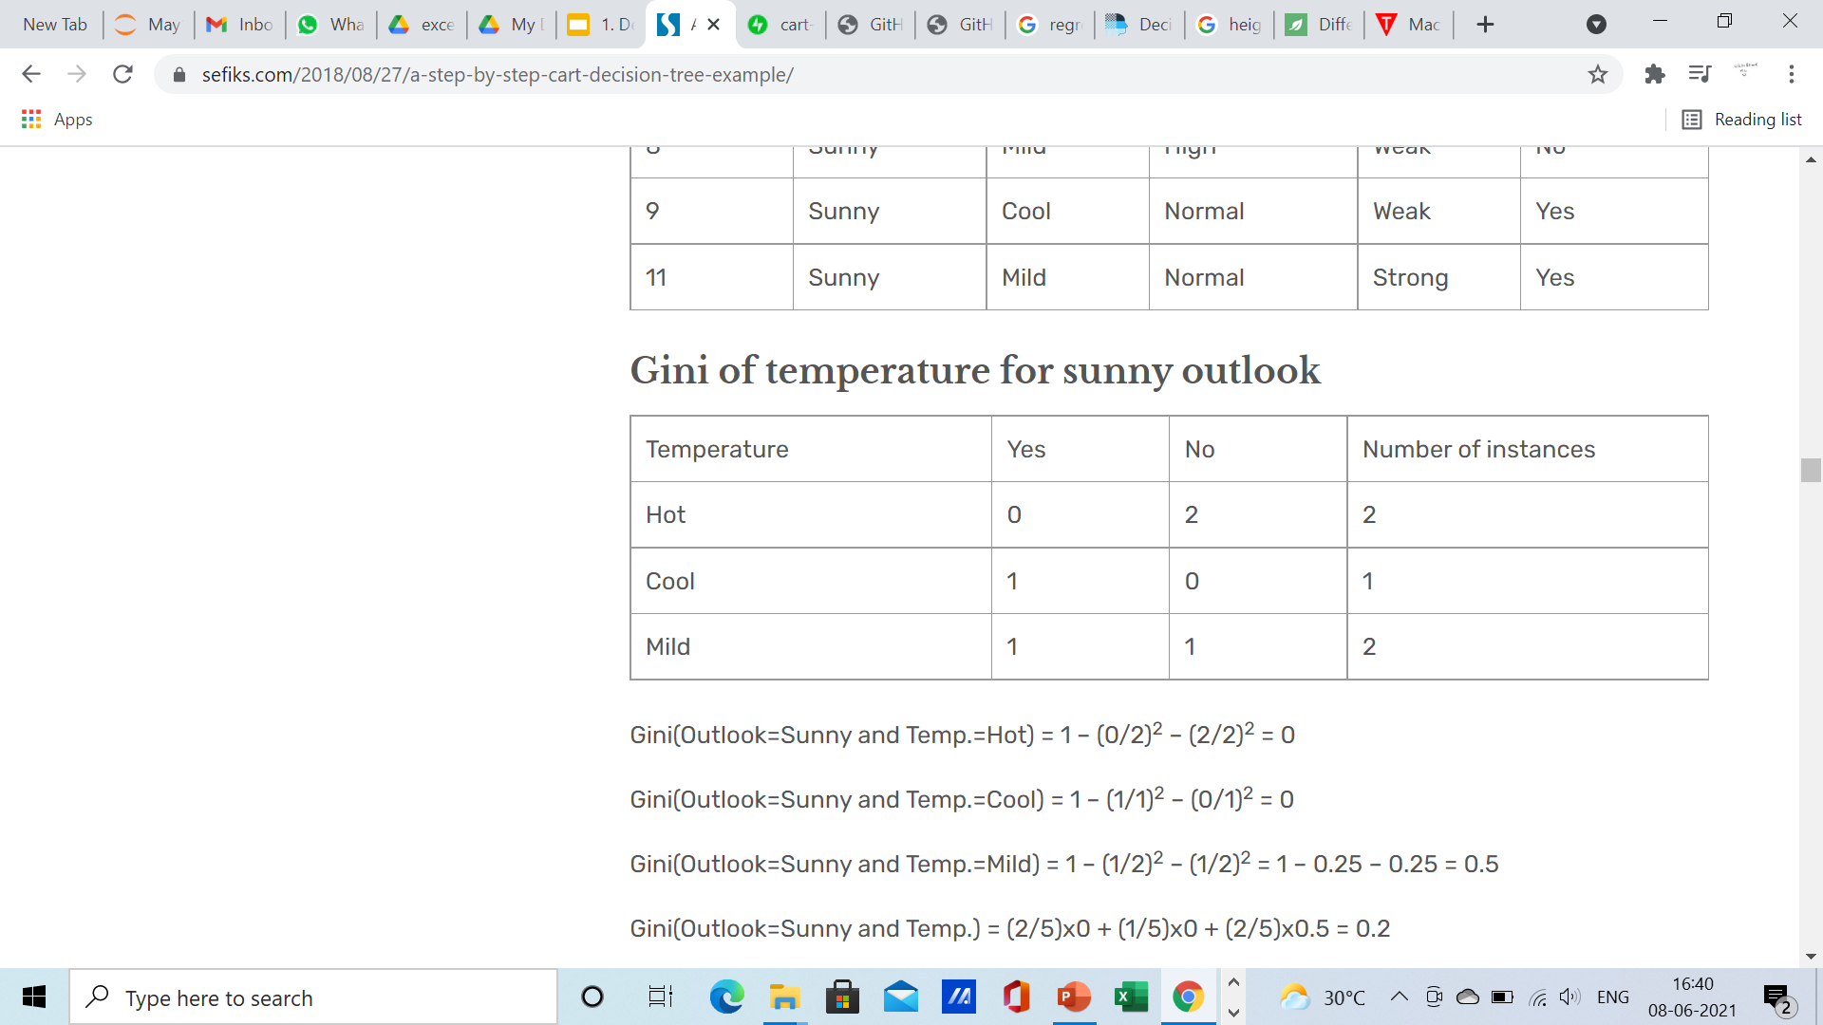
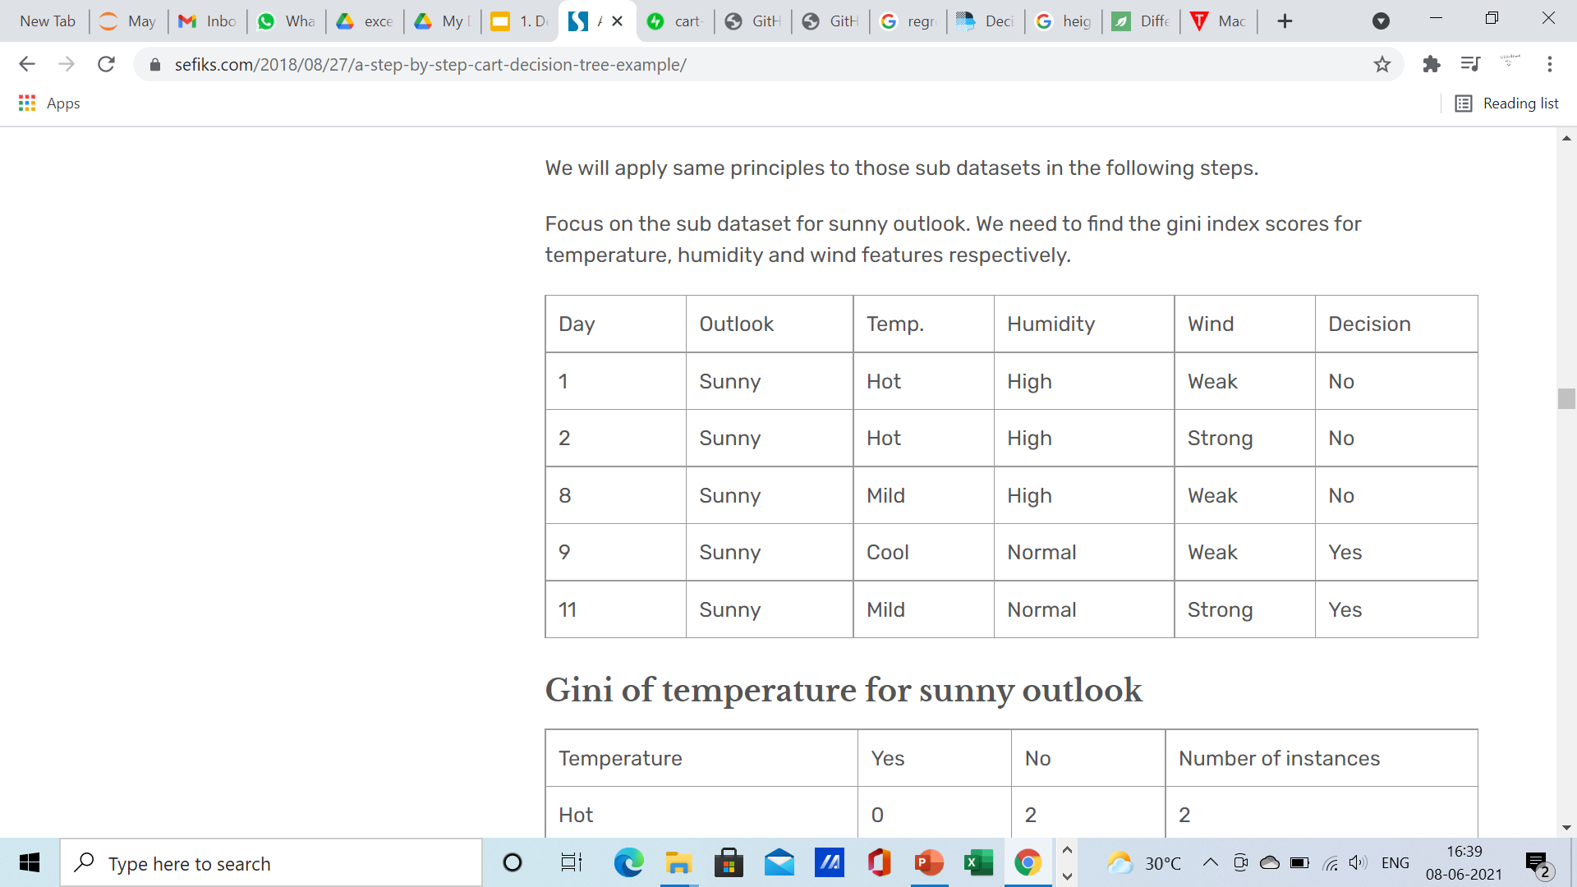
We will apply same principles to those sub datasets in the following steps. Focus on the sub dataset for sunny outlook. We need to find the gini index scores for temperature, humidity and wind features respectively.

Slide 43
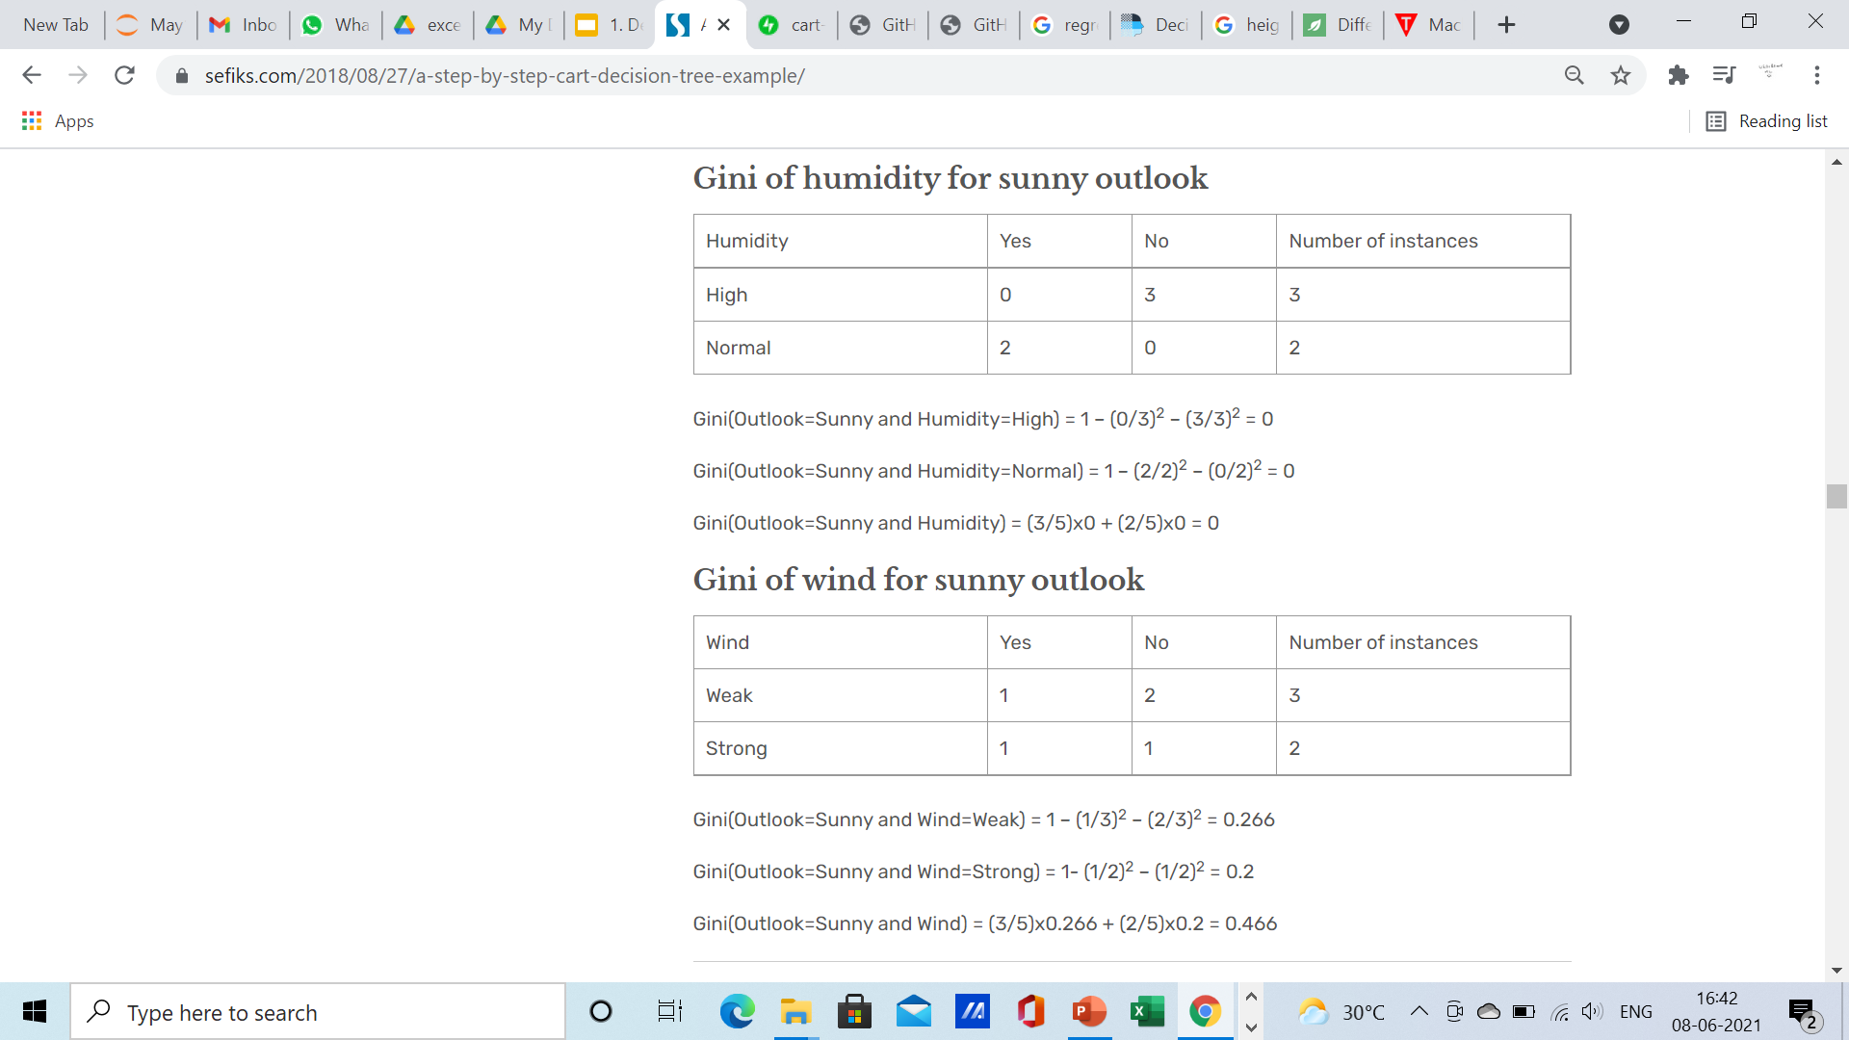

Slide 44
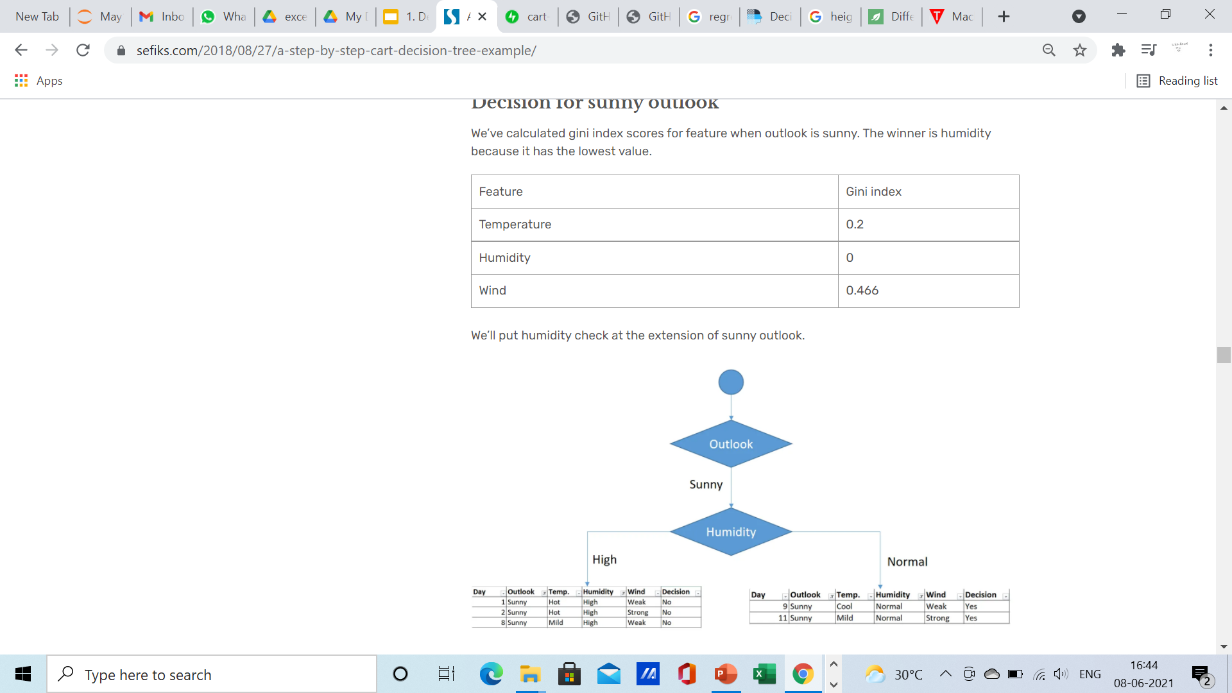
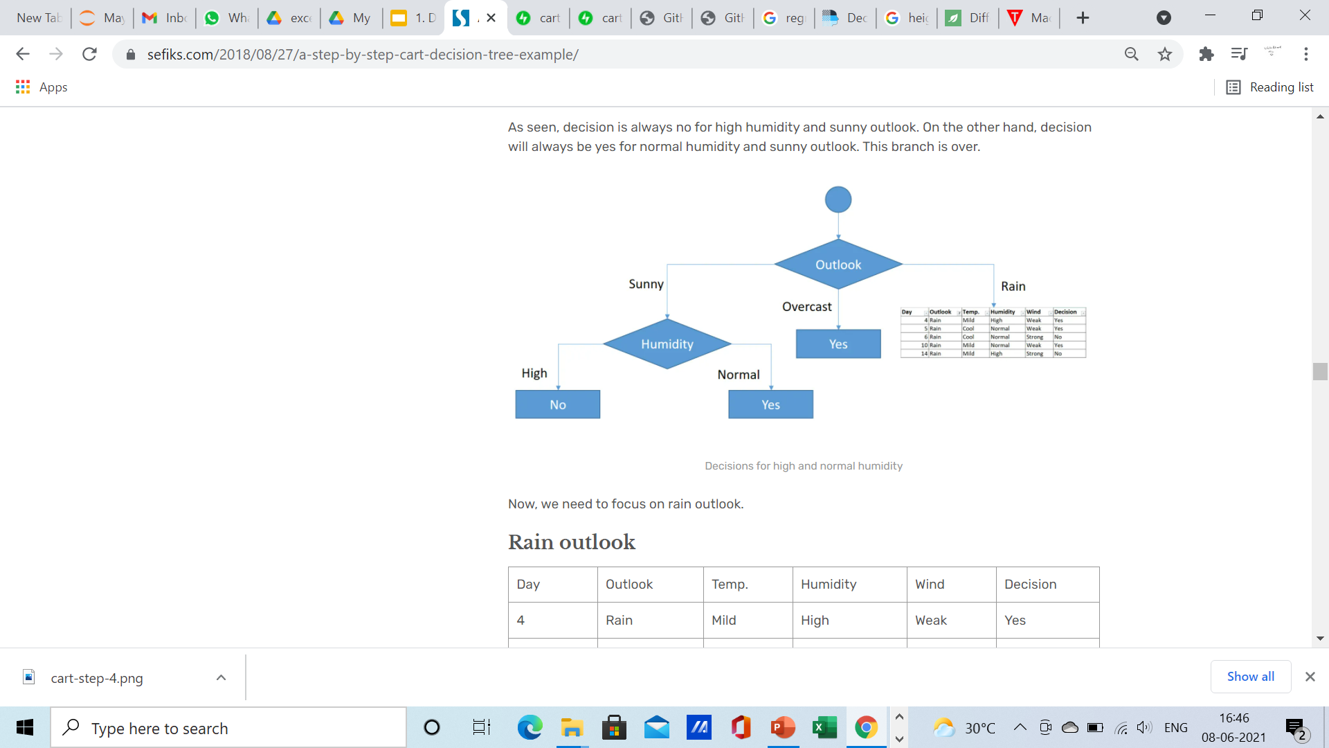
Decision for sunny outlook
We’ve calculated gini index scores for feature when outlook is sunny. The winner is humidity because it has the lowest value.
As seen, decision is always no for high humidity and sunny outlook. On the other hand, decision will always be yes for normal humidity and sunny outlook. This branch is over.

Slide 45
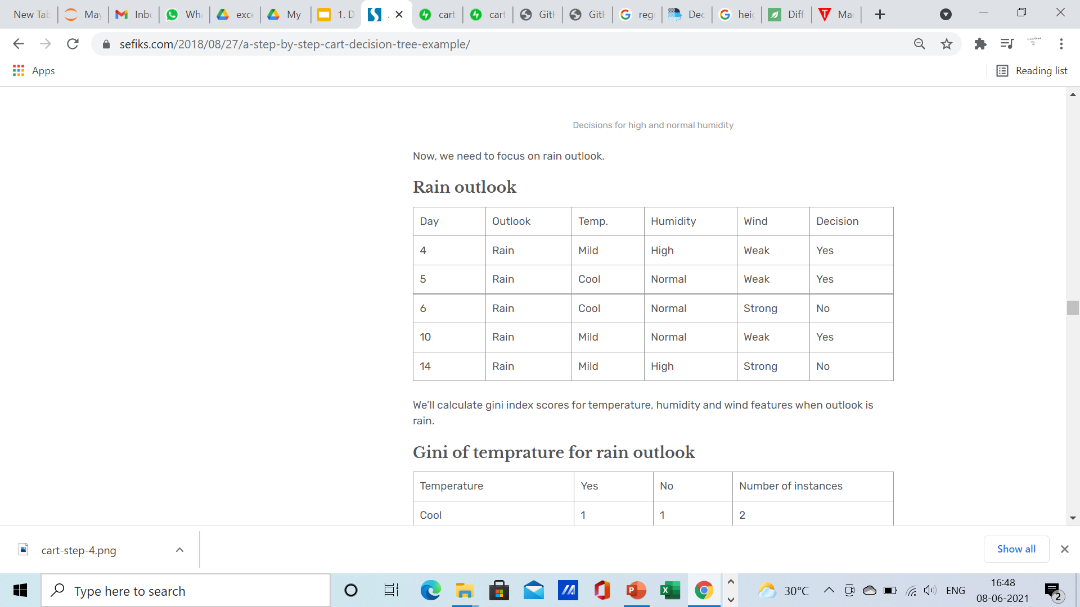
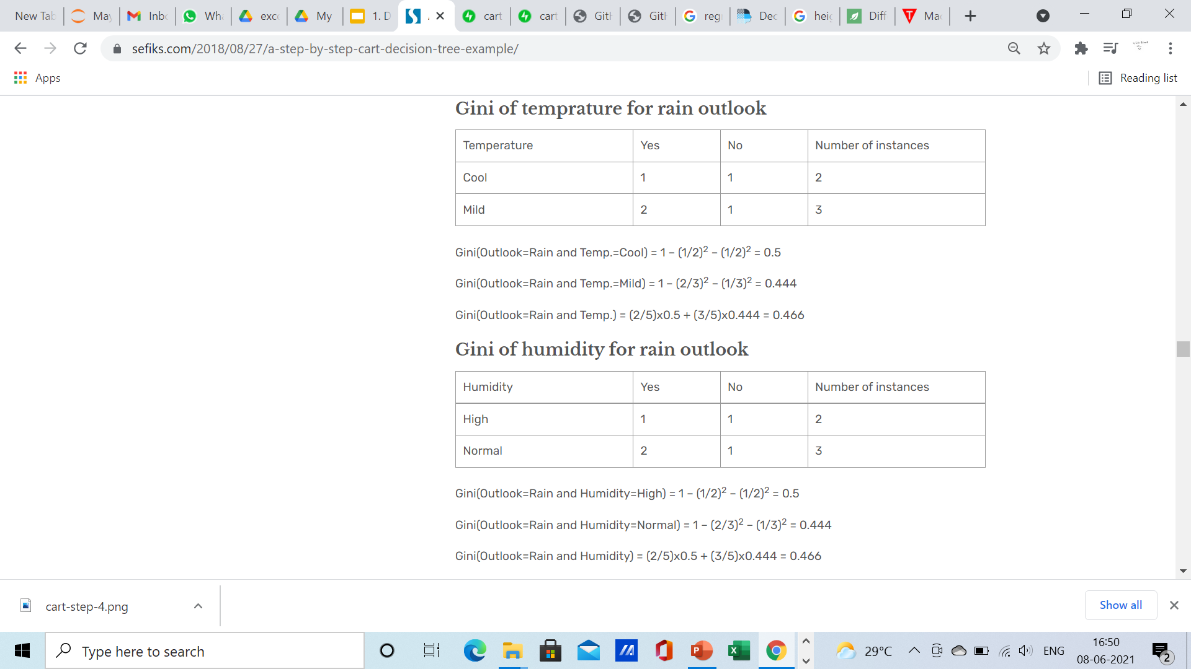
Now, we need to focus on rain outlook.

Slide 46
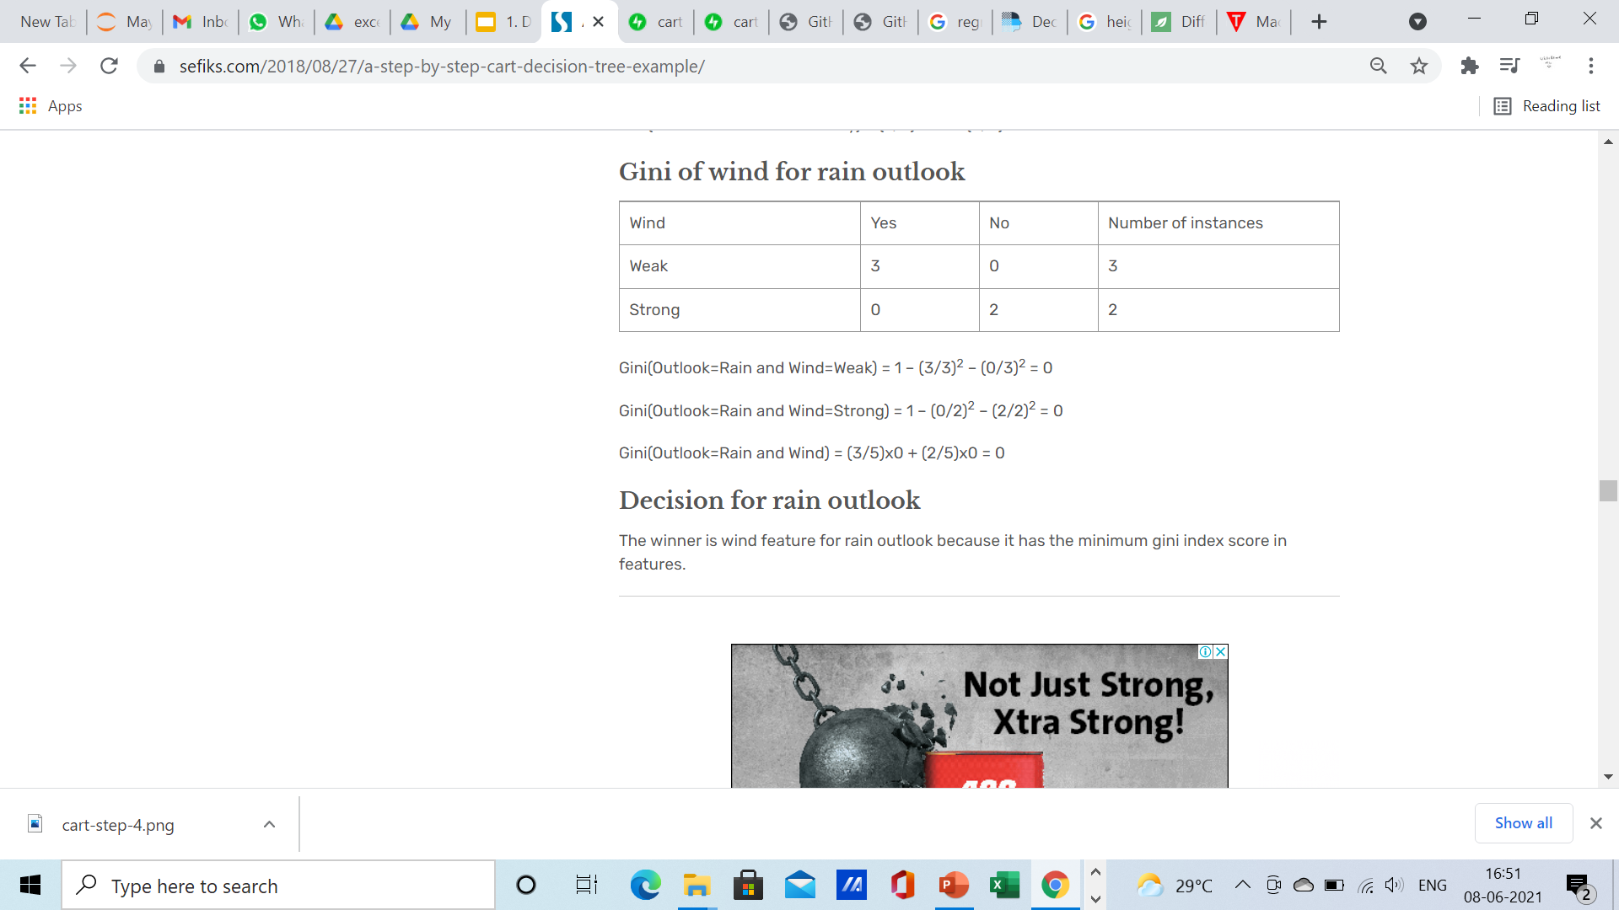
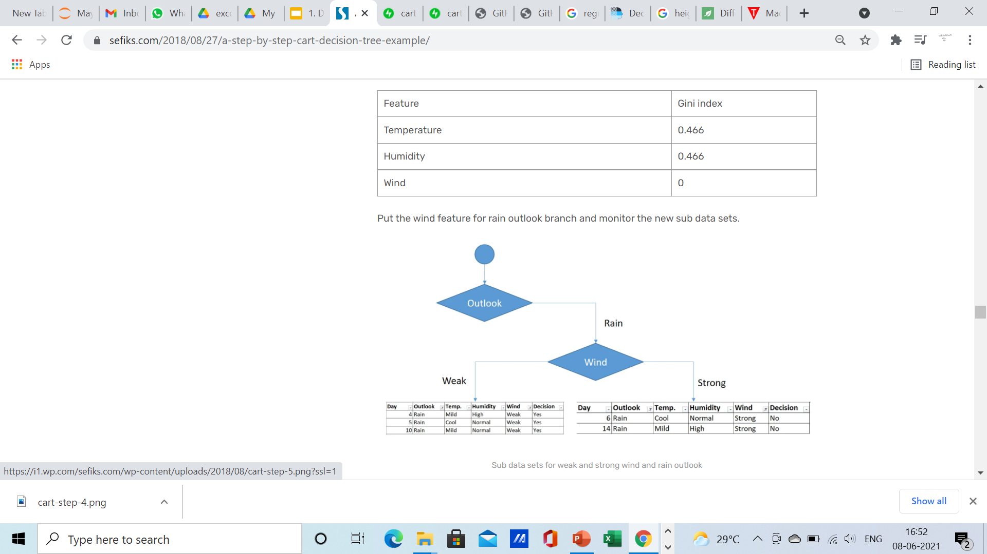
Decision for rain outlook
The winner is wind feature for rain outlook because it has the minimum gini index score in features.

Slide 47
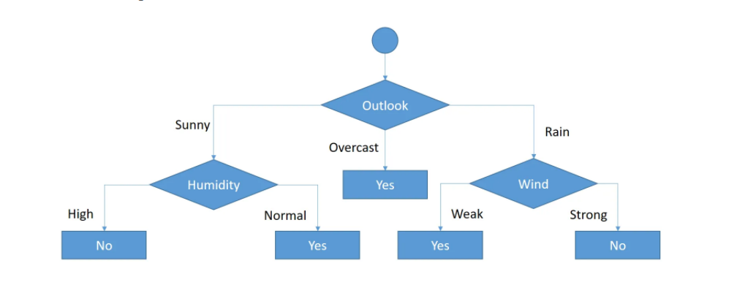
As seen, decision is always yes when wind is weak. On the other hand, decision is always no if wind is strong. This means that this branch is over.

Slide 48
Pros of Decision Tree
Easy to Understand: Decision tree output is very easy to understand even for people from non-analytical background. It does not require any statistical knowledge to read and interpret them.
Less data cleaning required: It requires less data cleaning compared to some other modeling techniques. It is not influenced by outliers and missing values to a fair degree.
Data type is not a constraint: It can handle both numerical and categorical variables.

Slide 49
Cons of Decision Tree
Over fit : Over fitting is one of the most practical difficulty for decision tree models.
Low accuracy for continuous variables: While working with continuous numerical variables, decision tree looses information when it categorizes variables in different categories.
They are unstable, meaning that a small change in the data can lead to a large change in the structure of the optimal decision tree.

Slide 50
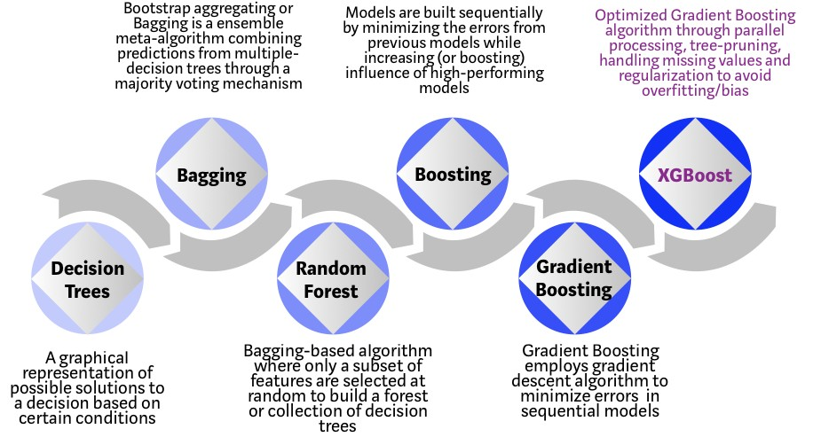
Ensemble Ensemble methods is a machine learning technique that combines several base models in order to produce one optimal predictive model
Most widely used non-DL machine learning models

Slide 51
Bagging (Boot Strap Aggregating)

Slide 52
Bootstrap Sampling

Slide 53
Bagging classifier

Slide 54
Random Forests
= Bagging w. trees + random feature subsets
“… random forest with random features is formed by selecting at random, at each node, a small group of input variables to split on.”

Slide 55
Bias and Variance Example
here, suppose if we fit a simple linear model (linear regression) or a decision tree stump

Slide 56
Bias and Variance Example
where f(x) is some true (target) function the blue dots are a training dataset; suppose if we fit an unpruned decision tree

Slide 57
So, why does bagging work/what does it do?
where f(x) is some true (target) function suppose we have multiple training sets

Slide 58
Pros and cons
It reduces overfitting in decision trees and helps to improve the accuracy
It is flexible to both classification and regression problems
It works well with both categorical and continuous values
4. Normalising of data is not required as it uses a rule-based approach.
Cons
It requires much computational power as well as resources as it builds numerous trees to combine their outputs.
It also requires much time for training as it combines a lot of decision trees to determine the class.
Due to the ensemble of decision trees, it also suffers interpretability and fails to determine the significance of each variable.

Slide 59
BOOSTING
Yet another approach for improving the predictions resulting from a decision tree.
Like bagging , it can be applied to both regression and classification
Recall that bagging involves creating multiple copies of the original training dataset using bootstrap, fitting a separate decision tree to each copy, and combining all of the trees in order to create a single predictions model.
Notably, each trees built on a bootstrap data set, independent of the other tress.
Boosting works in a similar way, except that the trees are sequentially built; each tree is grown using the information from previously grown trees.

Slide 60
Gradient Boosting -- Conceptual Overview
• Step 1: Construct a base tree (just the root node)
• Step 2: Build next tree based on errors of the previous tree
• Step 3: Combine tree from step 1 with trees from step 2. Go back to step 2.

Slide 61
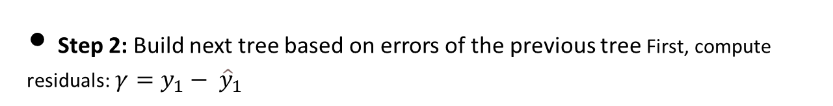
• Step 2: Build next tree based on errors of the previous tree First, compute residuals: $γ=y_{1}− {\hat{y}}_{1}$

Slide 62
• Step 2: Build next tree based on errors of the previous tree Then, create a tree based on to fit the residuals x1, . . . , xm

Slide 63
Step 3: Combine tree from step 1 with trees from step 2

Slide 64
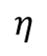
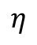
0.5875 + × (−0.4125) where learning rate between 0 and 1 (if , low bias but high variance) = 1
$$η$$
$$η$$

Slide 65
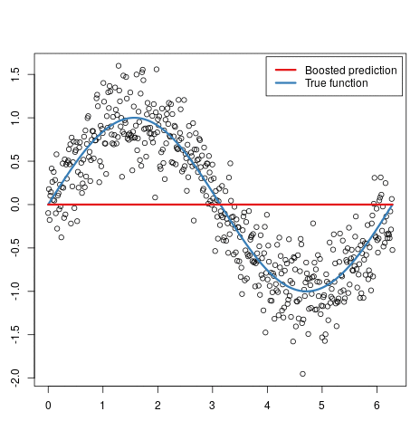
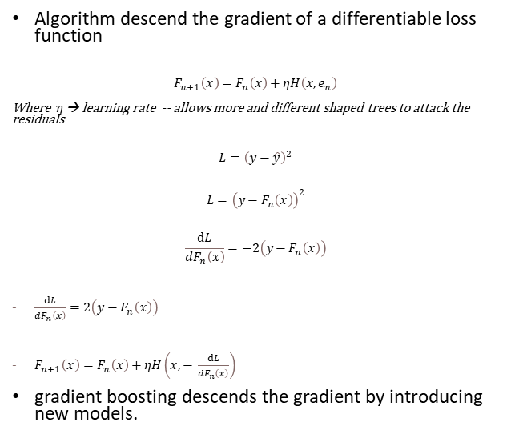
Gradient boosting machines
Algorithm descend the gradient of a differentiable loss function
$$F_{n+1}\left(x\right)=F_{n}\left(x\right)+ηH\left(x,e_{n}\right)$$
Where $η$ → learning rate -- allows more and different shaped trees to attack the residuals
$$L={\left(y−\hat{y}\right)}^{2}$$
$$L={\left(y−F_{n}\left(x\right)\right)}^{2}$$
$$\frac{ⅆL}{dF_{n}\left(x\right)}=−2\left(y−F_{n}\left(x\right)\right)$$
$\frac{ⅆL}{dF_{n}\left(x\right)}=2\left(y−F_{n}\left(x\right)\right)$
$F_{n+1}\left(x\right)=F_{n}\left(x\right)+ηH\left(x,− \frac{ⅆL}{dF_{n}\left(x\right)}\right)$
gradient boosting descends the gradient by introducing new models.
Loss
Number of trees

Slide 66
Xgboost
Both xgboost and gbm follows the principle of gradient boosting.
The name xgboost, though, actually refers to the engineering goal to push the limit of computations resources for boosted tree algorithms.
Improved data structures for better processor cache utilization which makes it faster.
Better support for multicore processing which reduces overall training time.

